Slide 1

Object Detection
Object detection
deeplearning.ai

Slide 2
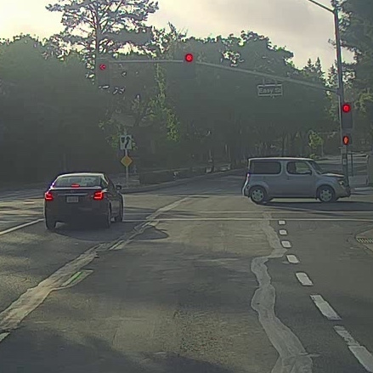
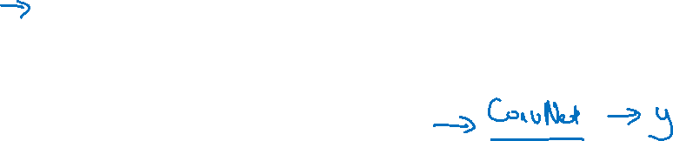
Car detection example
Training set:
x
y
1
1
1
0
0
Notes:
Stride要小：每个都要检查
之前的linear的classification滑窗很快
现在conv复杂了，滑窗很慢

Slide 3
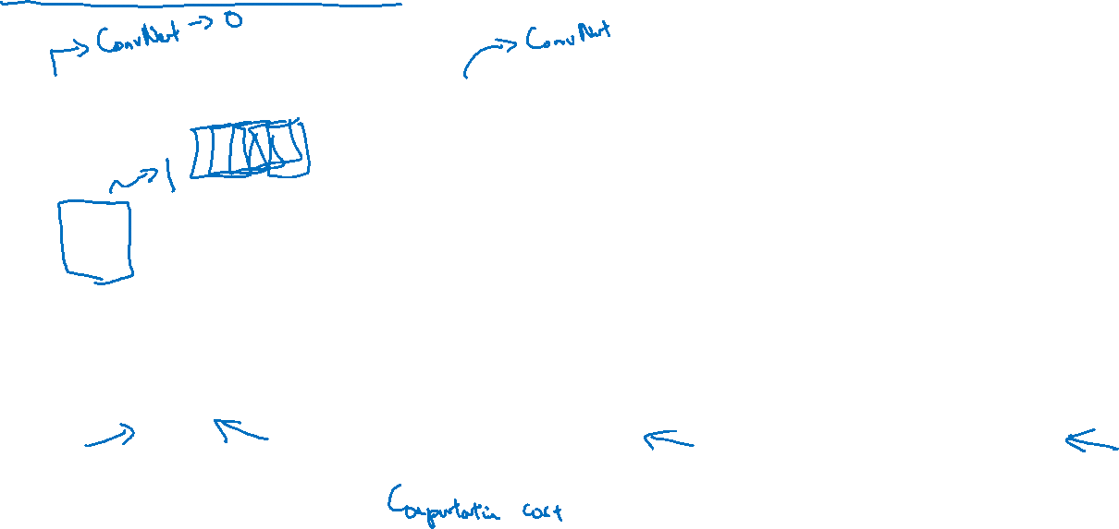
Sliding windows detection

